Slide 1
Detecting Stance of Tweets Toward Truthfulness of Factual Claims
Zhengyuan Zhu, Zeyu Zhang, Foram Patel, Chengkai Li
The Innovative Data Intelligence Research Laboratory(IDIR Lab)
Department of Computer Science and Engineering
2022 Computation + Journalism Conference
June 10th, 2022

Slide 2
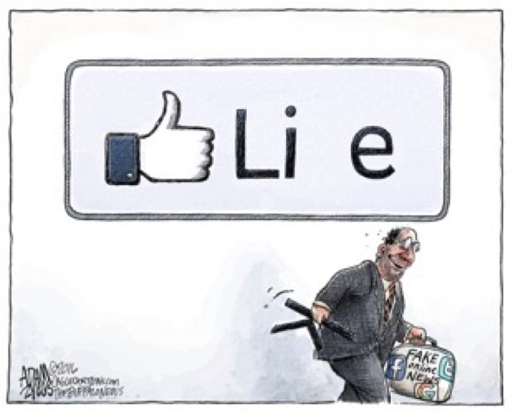
Overview
A factual claim can be false information or a true fact.
Image source: https://indepest.com/2020/05/08/fake-news/

Slide 3
Overview
A factual claim can be false information or a true fact.
False information can be easily internalized and true fact can be unacknowledged by social media users.
Image source: https://indepest.com/2020/05/08/fake-news/

Slide 4
Overview
A factual claim can be false information or a true fact.
False information can be easily internalized and true fact can be unacknowledged by social media users.
The spread and influence of factual claims are reflected by public opinion toward their veracity.
Image source: https://indepest.com/2020/05/08/fake-news/

Slide 5
Overview
The quest to discern the public opinions toward the veracity of factual claim.
Our society is damaged by the dispute of social media users who believe
false information is true
a true fact is false

Slide 6
Overview
The quest to discern the public opinions toward the veracity of factual claim.
Our society is damaged by the dispute of social media users who believe
false information is true
a true fact is false
Journalists are working hard on
comprehending the spreading of misinformation
mitigating the vicious impact of misinformation
Notes:
Social media posts make false claim.
False claim examples: “The COVID-19 vaccine is the deadliest vaccine ever made” “A viral photo shows the freedom convoy in Canberra, Australia, with over 1.5 million” “CNN confirms Trump WILL be ARRESTED”
Misinformation exacerbates the vicious impact
vicious impact examples: Drown out credible information Interfere with measures to contain the outbreak Deplete resources and overloads the health care system

Slide 7
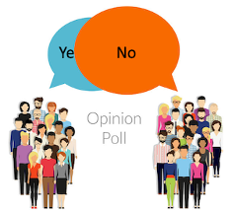
Overview
What is stance detection in general?
Determining whether a user supports or refutes a target based on their social media post.
Image source: https://www.jdsupra.com/legalnews/don-t-fully-trust-public-opinion-polls-25406/

Slide 8
Overview
What is stance detection in general?
Determining whether a user supports or refutes a target based on their social media post.
General stance detection example:
Target: Immigration
Notes:
1.False claim examples: “The COVID-19 vaccine is the deadliest vaccine ever made” “A viral photo shows the freedom convoy in Canberra, Australia, with over 1.5 million” “CNN confirms Trump WILL be ARRESTED”
2.vicious impact examples: Drown out credible information Interfere with measures to contain the outbreak Deplete resources and overloads the health care system
3.In stance detection example: the factual claim is misinformation

Slide 9
Overview
What is stance detection in general?
Determining whether a user supports or refutes a target based on their social media post.
General stance detection example:
Target: Immigration
Tweet: “Unregulated immigration that hurts working Americans and globalism which only further weakens America!”

Slide 10
Overview
What is stance detection in general?
Determining whether a user supports or refutes a target based on their social media post.
General stance detection example:
Target: Immigration
Tweet: “Unregulated immigration that hurts working Americans and globalism which only further weakens America!”
Stance: Refute
Notes:
1.False claim examples: “The COVID-19 vaccine is the deadliest vaccine ever made” “A viral photo shows the freedom convoy in Canberra, Australia, with over 1.5 million” “CNN confirms Trump WILL be ARRESTED”
2.vicious impact examples: Drown out credible information Interfere with measures to contain the outbreak Deplete resources and overloads the health care system
3.In stance detection example: the factual claim is misinformation

Slide 11
Overview
The emphasis of our study:
The target of stance is a factual claim.
The stance refers to a Twitter user’s belief or assertion regarding the truthfulness of a factual claim.

Slide 12
Overview
The emphasis of our study:
The target of stance is a factual claim.
The stance refers to a Twitter user’s belief or assertion regarding the truthfulness of a factual claim.
An example of truthfulness stance:
Claim: Rep. Paul Gosar asks Capitol Police to arrest illegal immigrants attending State of the Union.

Slide 13
Overview
The emphasis of our study:
The target of stance is a factual claim.
The stance refers to a Twitter user’s belief or assertion regarding the truthfulness of a factual claim.
An example of truthfulness stance:
Claim: Rep. Paul Gosar asks Capitol Police to arrest illegal immigrants attending State of the Union.
Tweet: They don't even try to hide their racism anymore! Remember his name at Election time! GOP Rep. Paul Gosar asks Capitol Police to arrest undocumented immigrants at State of the Union.

Slide 14
Overview
The emphasis of our study:
The target of stance is a factual claim.
The stance refers to a Twitter user’s belief or assertion regarding the truthfulness of a factual claim.
An example of truthfulness stance:
Claim: Rep. Paul Gosar asks Capitol Police to arrest illegal immigrants attending State of the Union.
Truthfulness Stance: Positive
Tweet: They don't even try to hide their racism anymore! Remember his name at Election time! GOP Rep. Paul Gosar asks Capitol Police to arrest undocumented immigrants at State of the Union.

Slide 15
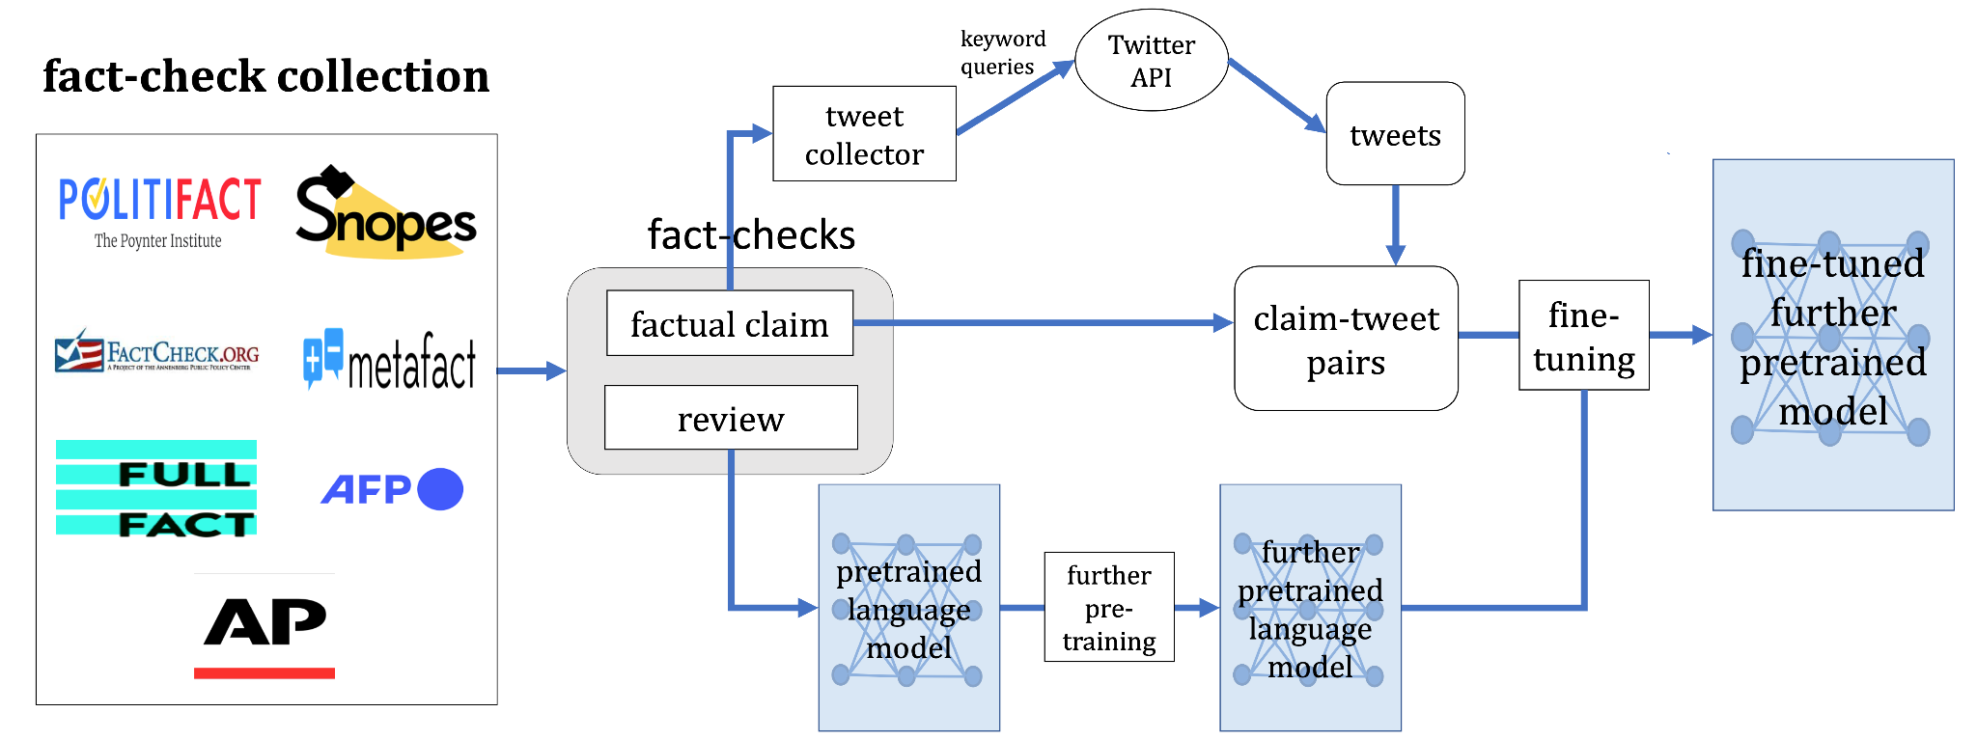

Data Collection
We extracted factual claims and reviews from various trust-worthy websites.
Notes:
53,724

Slide 16
Data Collection
We fetched claim-related English tweets using keyword queries to Twitter API.
Notes:
18,088

Slide 17
Data Collection
We annotated claim-tweet pairs by five options:
Positive, Negative, Neutral, Unrelated, Invalid.
The claim-tweet pairs are used for training stance detection model which take claim-tweet pair as input and generate the stance prediction.

Slide 18
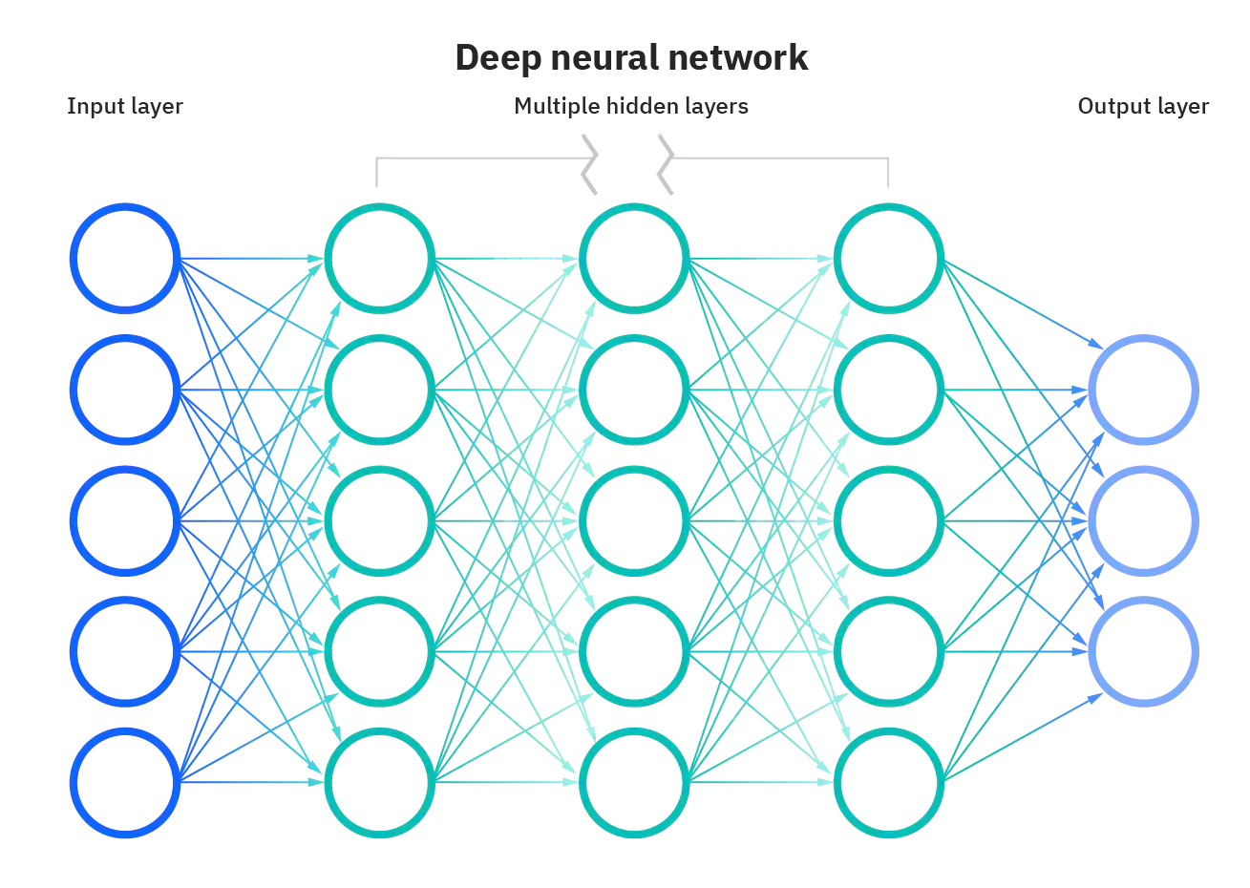
Methodology
Further pretraining language model
Language models are large neural networks that are used in a wide variety of natural language processing tasks.
Weights
Image source: https://www.ibm.com/cloud/learn/neural-networks

Slide 19
Methodology
Further pretraining language model
Language models are large neural networks that are used in a wide variety of natural language processing tasks.
Language models that have been trained with a large corpus still don’t have domain knowledge about journalism.

Slide 20
Methodology
Further pretraining language model
Language models are large neural networks that are used in a wide variety of natural language processing tasks.
Language models that have been trained with a large corpus still don’t have domain knowledge about journalism.
Further pretrain language model on fact-check reviews can guide language models to comprehend the semantics of factual claims.

Slide 21
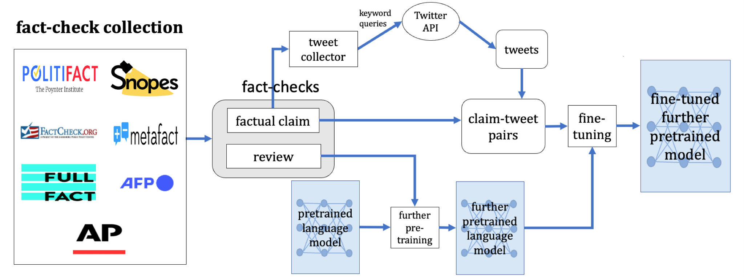
Methodology
Further pretraining language model on fact-check reviews

Slide 22
Methodology
Fine-tune language model
Fine-tune refers to the procedure of re-training a language model on annotated claim-tweet pairs.
The weights of the language model are updated to account for the claim-tweet pairs’ characteristics of the stance detection.

Slide 23
Methodology
Fine-tune language model on annotated claim-tweet pairs
Notes:
18,088

Slide 24
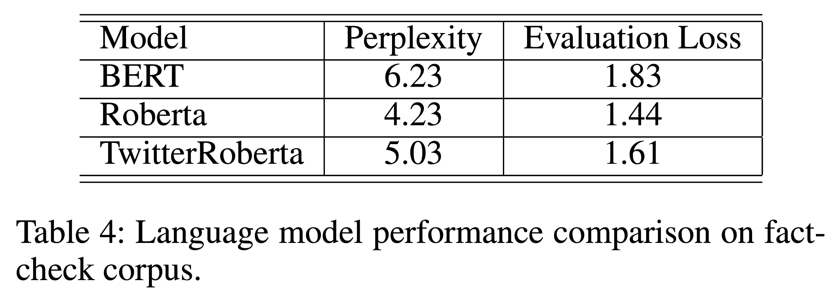
Model Evaluation: Further pretrain
Roberta outperformed BERT and TwitterRoberta in predicting tokens in fact-checks by two evaluation metrics: perplexity (the lower the better) and loss (the lower the better).
Notes:
Put related works around overview.

Slide 25
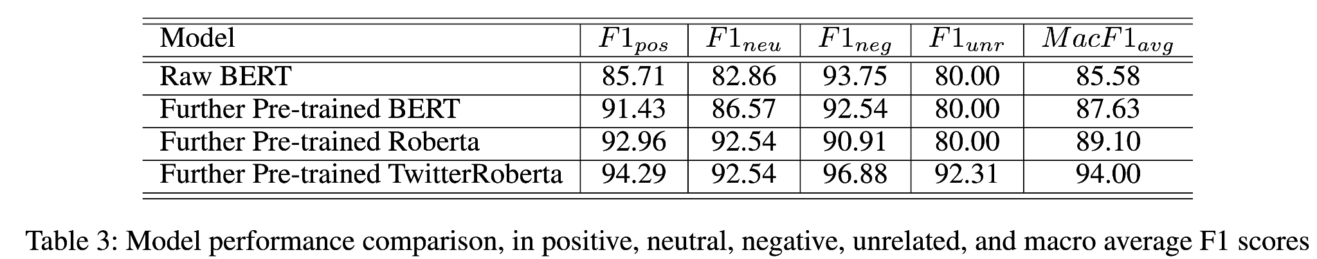
Model Evaluation: Stance detection
TwitterRoberta outperformed all other further pre-trained language models in predicting truthfulness stance by F1 score.

Slide 26
Model Evaluation: Stance detection
TwitterRoberta outperformed all other further pre-trained language models in predicting truthfulness stance by F1 score.
F1 score considers both
how many of the predictions are correct.
how many of the class samples are correctly predicted

Slide 27
Conclusion
We formulated the concept of truthfulness stance detection.
We proposed a novel stance detection model which is based on additional pre-training of pre-trained language models using fact-checks.
We created an API to allow for programmatic and large-scale usage of the tool.

